Slide 1
Predicting Solubility of Small Organic Molecules Using Melting Points Dataset
Grace Nye

Slide 2
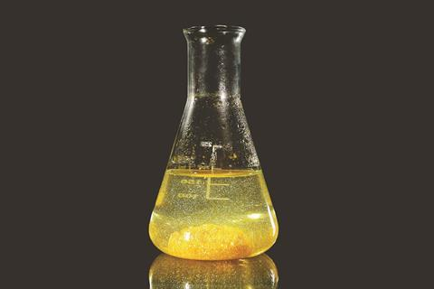
Solubility
Essential to know for drug characterization
Experimental methods are not high-throughput
Existing datasets are small and highly variable…

Slide 3
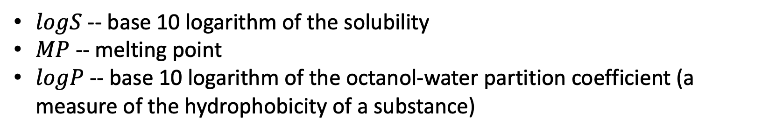
General Solubility Equation
$$logS=0.5 −0.01∗\left(MP −25\right)−logP$$
$logS$ -- base 10 logarithm of the solubility
$MP$ -- melting point
$logP$ -- base 10 logarithm of the octanol-water partition coefficient (a measure of the hydrophobicity of a substance)

Slide 4
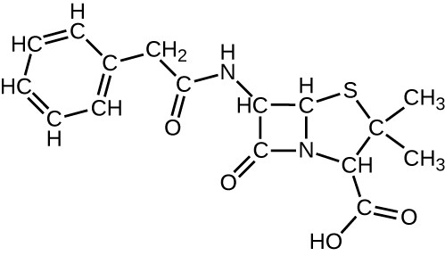
Melting Point Dataset
Cambridge Crystallographic Data Centre
58810 molecules with melting point data
2D molecular descriptors
RDKit.Chem.Descriptors
Calculated from the chemical structure
Molecular weight, aromaticity, hydrophobicity, etc.

Slide 5
External Validation Datasets
Dataset 1 – 72 small molecule drugs
Dataset 2 – 132 compounds from solubility challenge
Dataset 3 – 148 compounds from Ran & Yalkowsky (2001)
Dataset 4 – 900 compounds
Dataset 5 – 8613 compounds curated from AqSolDB
Dataset 6 – 21 proteolysis targeting chimeric (PROTAC) compounds

Slide 6
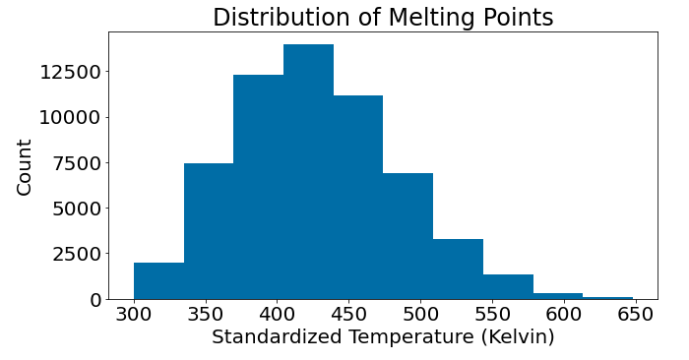
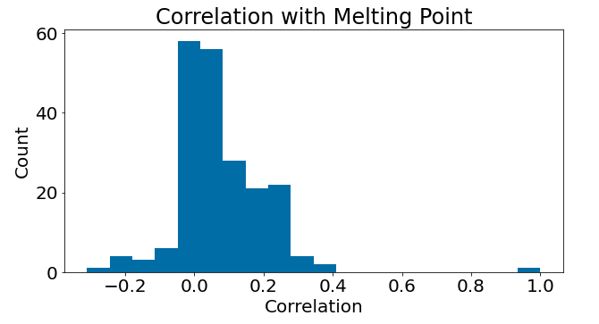
Melting Point Dataset
Fairly normal distribution of melting points
No clear linear relationship between any features
Most strongly correlated with RingCount – a measure of stability

Slide 7
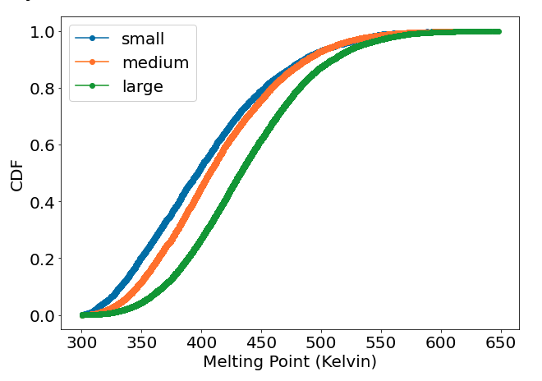
Melting Point & Molecule Size

Slide 8
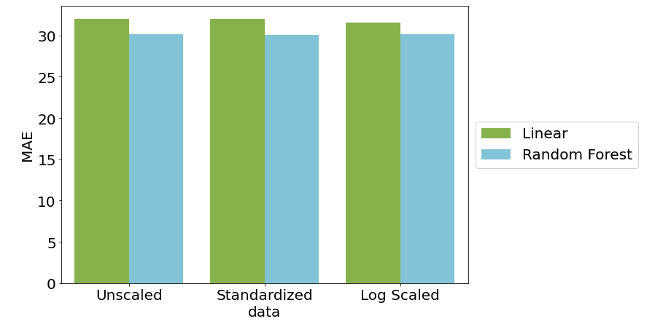
Modeling

Slide 9
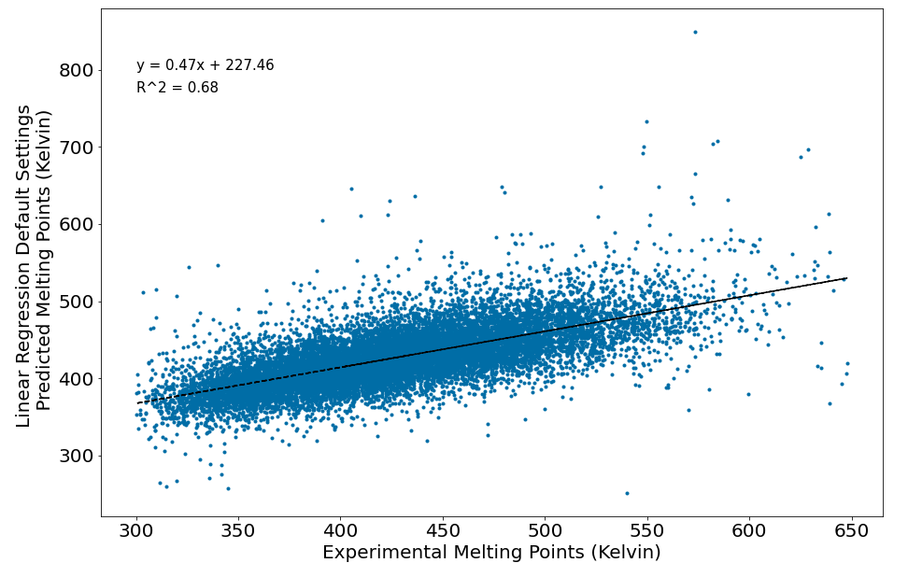
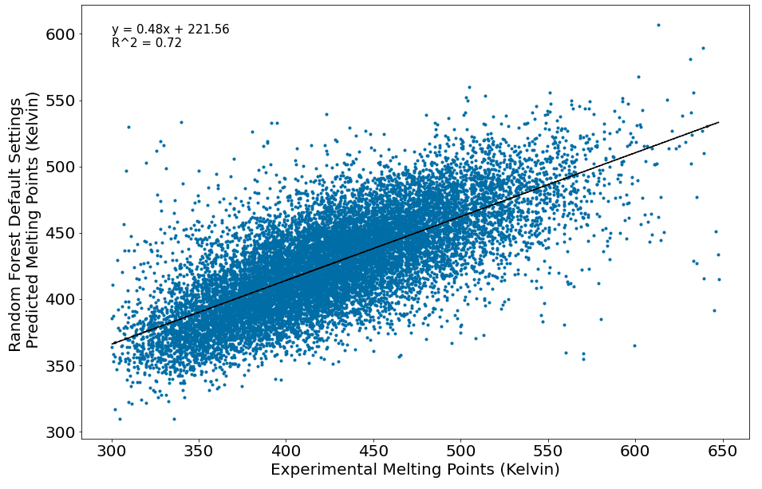
Modeling
Linear Regression
(default settings)
Random Forest Regressor
(default settings)
R² = 0.68
RMSE = 41.45
MAE = 31.97
R² = 0.72
RMSE = 39.31
MAE = 30.08

Slide 10
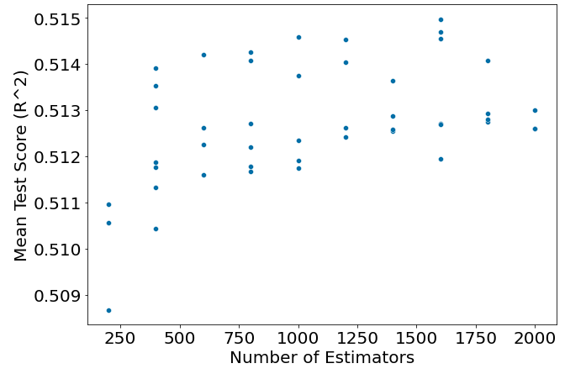
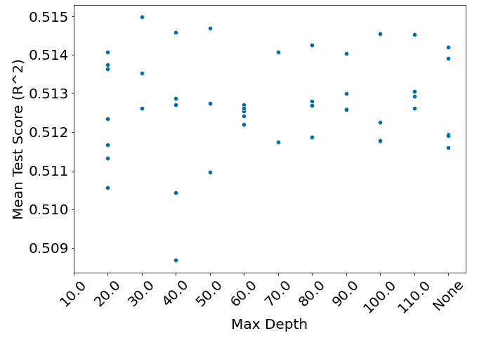
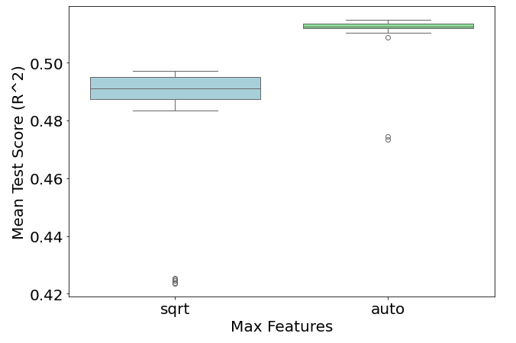
Parameter/Hyperparameter Tuning
sklearn.model_selection.RandomizedSearchCV

Slide 11

Best Model Performance on Melting Points
Parameters & Hyperparameters:
n_estimators = 1600
min_samples_split = 2
min_samples_leaf = 1
max_features = ‘auto’
max_depth=30

Slide 12
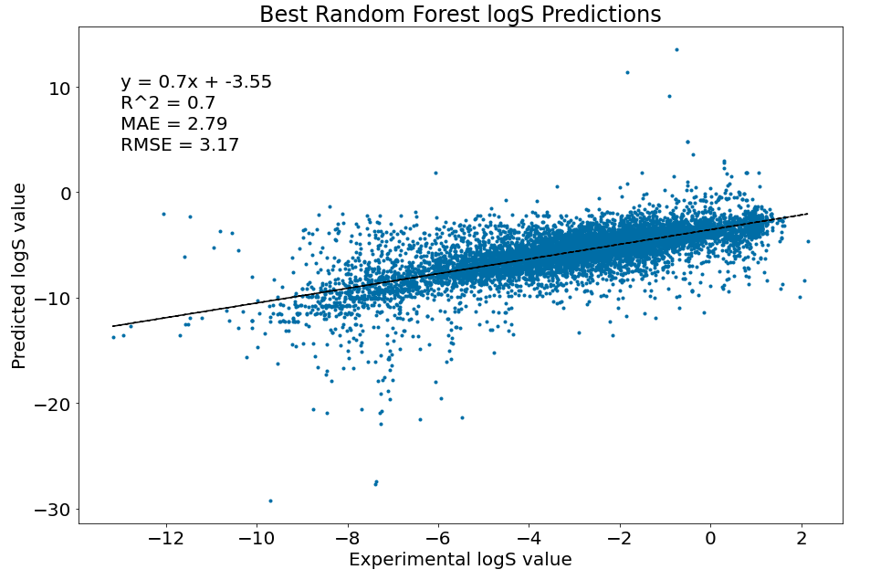

Slide 13
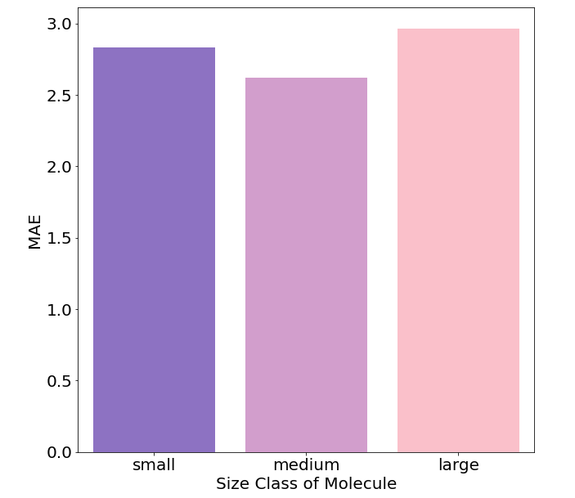
Molecule Size and Model Performance

Slide 14
Conclusion
Can predict melting points for molecules with MAE of 30.00 (comparable to existing models in the literature)
Can predict base 10 logarithm of solubility with MAE of 2.80
Model performs better on medium sized molecules (we are most interested in these as well)

Slide 15
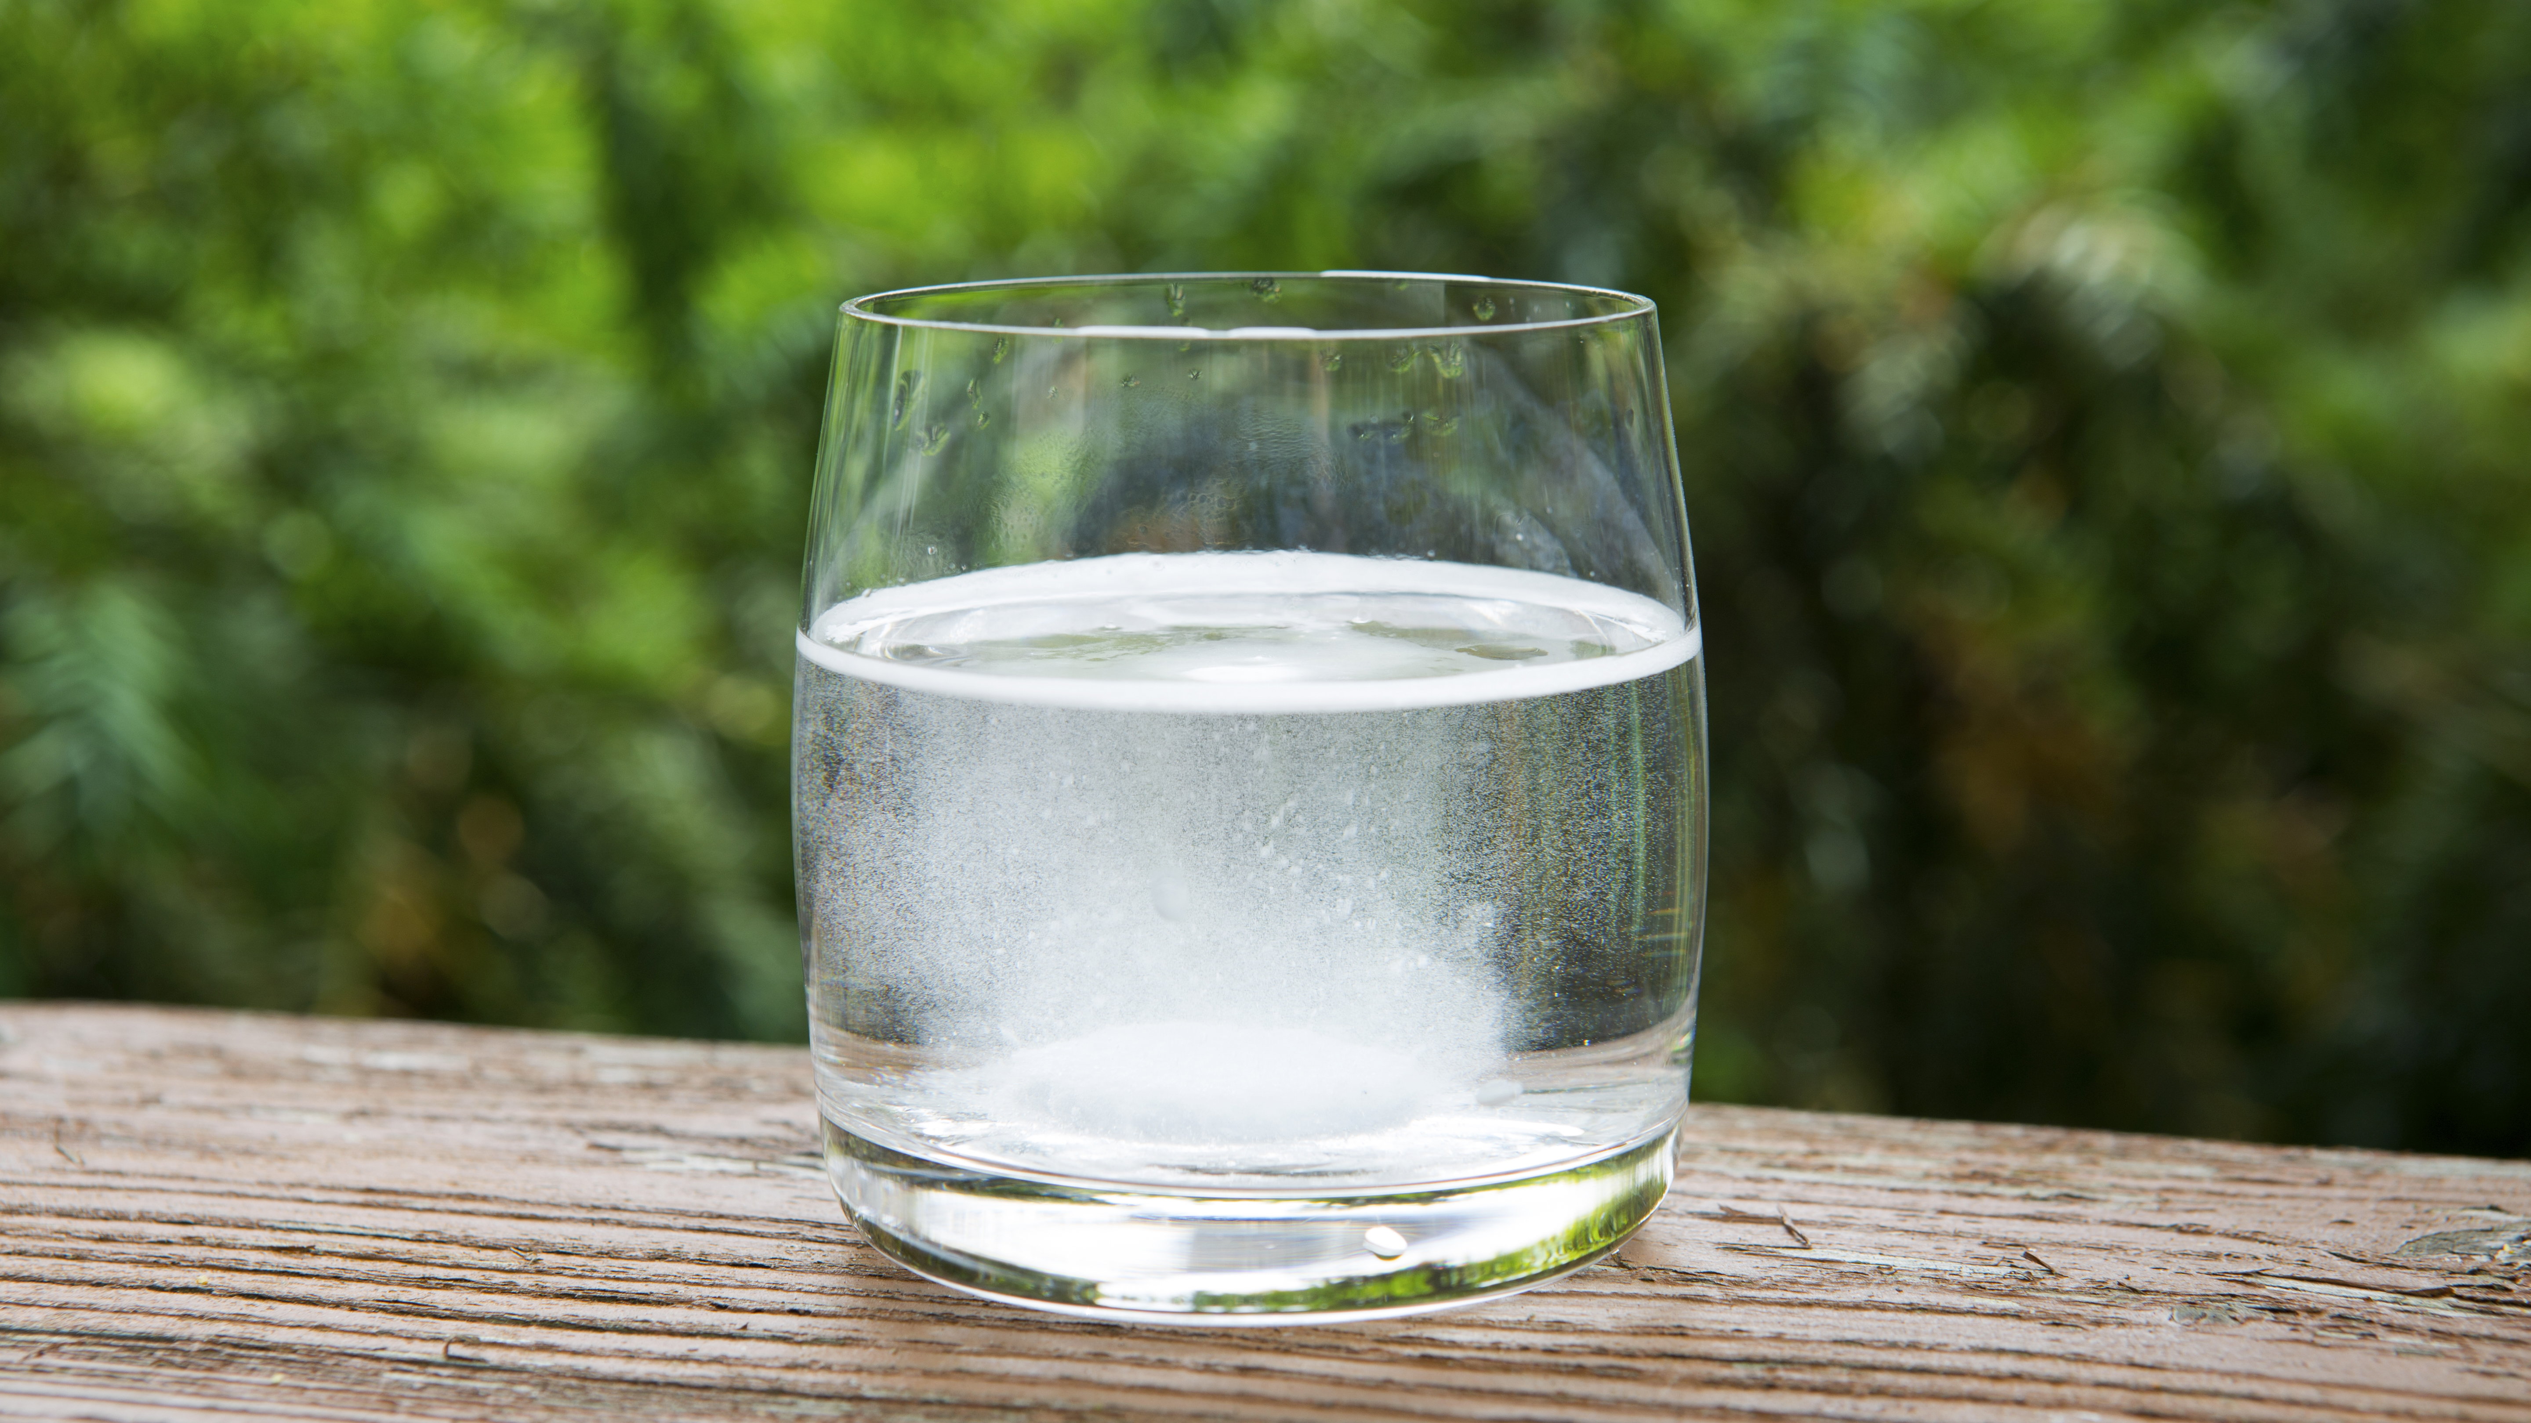
Future Directions
Building a model that goes straight to solubility using the ESOL dataset and 2D molecular descriptors?
Building a model with AqSolDB?
Lack of direct solubility data is a limiting factor – might find that model performance is worse since these datasets are small and varied

